Slide 1
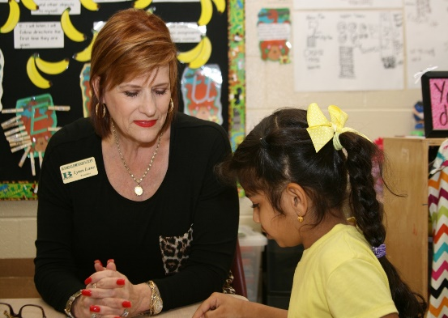
Georgia’s State Plan
Every Student Succeeds Act (ESSA)
Developing a Plan for Georgians, By Georgians

Slide 2
Federal Programs to Support School Improvement
Co- chairs
Debbie Gay
State Director, Special Education
dgay@doe.k12.ga.us
Leigh Ann Putnam
Director, Metro RESA
leighann.putman@mresa.org

Slide 3
Working Committee Charge
Identification of Comprehensive Support and Targeted Support and Improvement schools
Describe the type and quality of technical assistance
Align federal funds to support the districts to provide equity relative to subgroups
Ensure coordination of other federal programs – i.e., IDEA, WIOA, Perkins, McKinney-Vento
Coordinate and compliment local improvement efforts

Slide 4
Georgia Vision
Educating Georgia’s future by graduating students who are ready to learn, ready to live, ready to lead.

Slide 5
Guiding Principals
We must consider:

Slide 6
What has worked and what has not worked in previous state efforts to turn-around low performing schools?

Slide 7
How is Georgia building local capacity to sustain improvements?

Slide 8
What do we need to know from the community to move the work forward?

